Slide 1
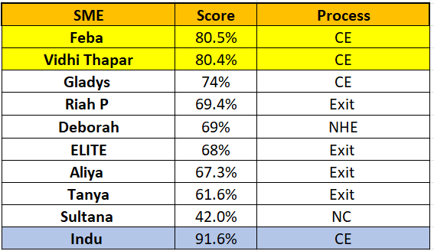
OVERALL BEST SME
Apr’23
Scoring methodology:
Parameters considered are:
% of team achieving all KRAs
Adherence/Productivity
Quality performance
Controllable & Red flag (for Exits)
Interventions & LinkedIn (for CE)
Weightage is assigned to each parameter
Score calculated for actual performance achieved

Slide 2



AceNgage
Dec’22 Performance Awards
AceNgage
Apr’23
Performance Awards

Slide 3

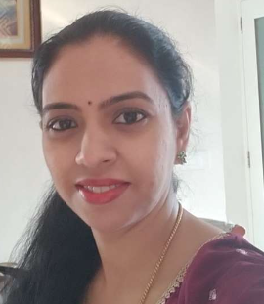


ACE PERFORMER
And she tops the charts again! Chaya has performed brilliantly over the last 6 months. Consistency is her middle name, be it in her productivity or her quality.
It is rare to find a team member who is constantly on top of her game month on month. But Chaya does exactly that. Over the months, she has inspired other team members to reach for the stars too – in this case hitting >190 interviews every month! Thank you for your efforts, Chaya!
Its exciting to see you achieve your numbers every month ! Keep Rocking !
CHAYA RAMESH
Digital Certificate and
Gift voucher

Slide 4
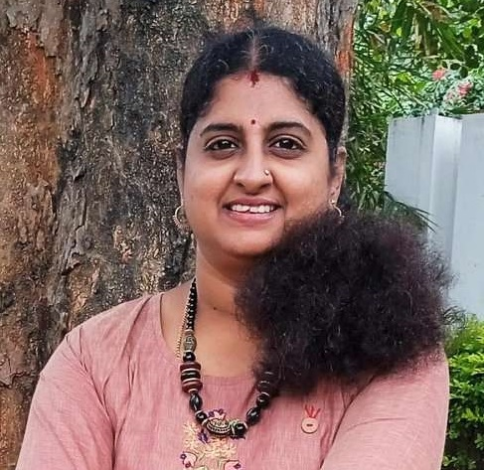
QUALITY PERFORMER
A mind blowing performance this month! With all 4 parameters in a bright green Swati has been the mainstay of the team.
Not just this month but every month. A consistently a powerful team member, Swati’s contributions are highly impactful and valuable.
Truly appreciate all that you do for us. Our team has grown so much because of your contributions. Your dedication and hard work is awe inspiring!
Keep shining the way you do always!
SWATHI M G
Digital Certificate and
Gift voucher

Slide 5
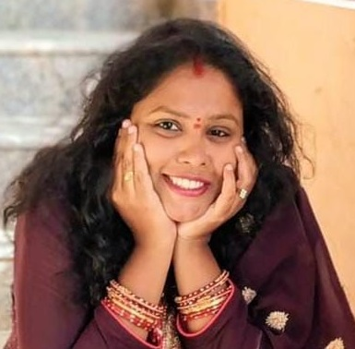
QUALITY PERFORMER
As always Priyanka has ended yet another month in style! While managing to overachieve all her KRA’s she has been outstanding in the quality of her calls.
A true blessing and an asset to the team and her SME, she handles her candidates with smoothness and grace. Her warm and friendly tone makes it easy for her to build a rapport with all of them.
She is pro-active by nature and takes ownership for her work. Continue to make us proud Priyanka !
PRIYANKA KUMAR
Digital Certificate and
Gift voucher

Slide 6

MOST IMPROVED PERFORMER
From listening to feedback and implementing each and every word that was told , she stands before us as one of the most improved performers.
Never says no to any work given to her and one of the favorite counsellors of the client . She always makes sure her work is completed without any delay.
She a very quick learner and a very enthusiastic and bubbly person. S
he always keeps the team happy and light.
SNEHA R H
Digital Certificate and
Gift voucher

Slide 7
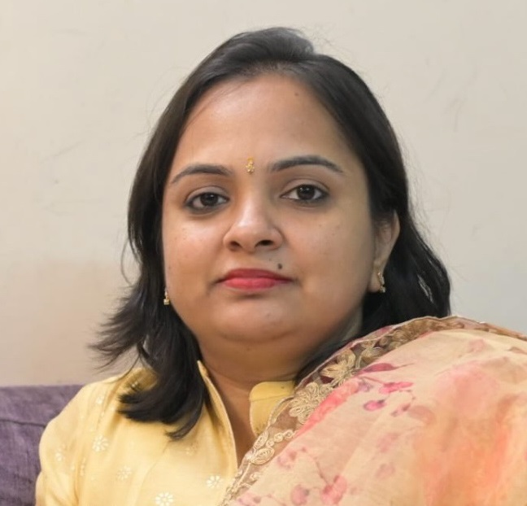
MOST IMPROVED PERFORMER
It’s been an eventful month for Monica. She has worked on all the feedback shared and has dutifully implemented each one of them.
She has taken up the challenge of working on her quality and productivity and we are delighted to see her achieve all her numbers.
Thank you for using your remarkable hard work to fuel our mutual efforts. Your performance has been incredible for April 2023 and you have proved to yourself that you can overcome any challenge.
We are proud of you to have you at AceNgage.
MONICA SRIVASTAVA
Digital Certificate and
Gift voucher

Slide 8
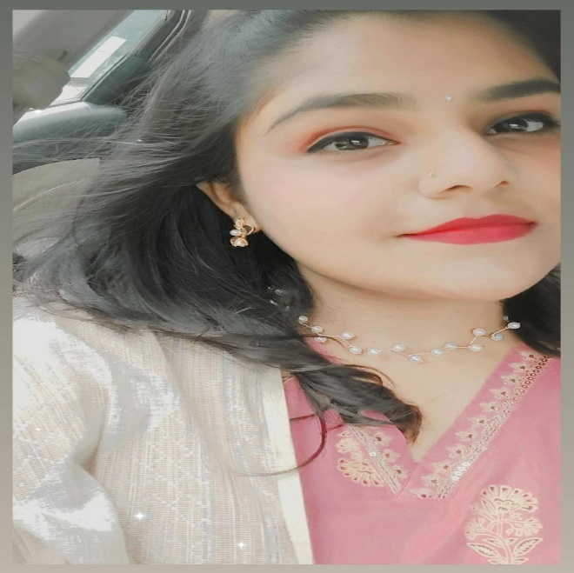
PAT ON THE BACK
She is an excellent team player with an outstanding quality of work.
Her work ethic and professionalism serve as a model for the rest of the team. Candidate engagement seems effortless, thanks to her remarkable skills in connecting with people!
Her confidence, dedication and commitment to excellence have made her an invaluable asset.
Proud to have you in our team!
SWATHI SHYAM
Digital Certificate and
Gift voucher

Slide 9

PAT ON THE BACK
Her hard work and dedication to the tasks given to her is highly appreciated.
Her tireless efforts and commitment to excellence are impressive!
She is an instrumental part of the team and goes above and beyond to ensure the best engagement is delivered to her candidates.
Over the months , she has also worked hard to improve her quality and get back on track.
Thank you for your efforts!
NEHA PRASAD
Digital Certificate and
Gift voucher

Slide 10
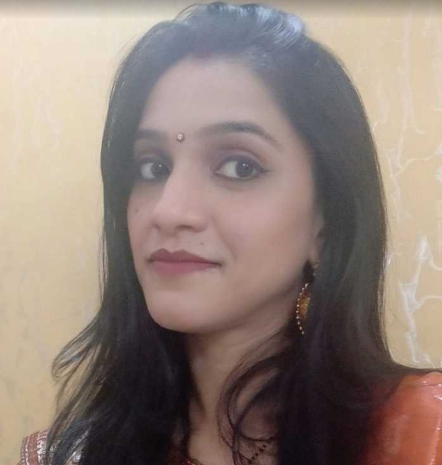
PAT ON THE BACK
She maintains a high level of quality at work and is always focused on completing the work on time.
Sneha ensures every task is understood and implemented well.
A veteran in the team she is known for being a dedicated and committed team member who is ready to help other team members too.
Looking forward to seeing you achieve a lot more.
She deserves a pat on the back!
SNEHA LAL
Digital Certificate and
Gift voucher

Slide 11
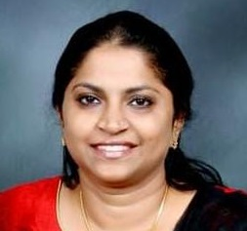
PAT ON THE BACK
We want to take a moment to recognize the exceptional work of Smita Alex from the Quality team. She consistently goes above and beyond to ensure that the Exit team is successful in achieving all the 4 KRA’s .
The Exit team raised 245 red flags in April and a major role was played by Smita for 3 months. This is one of the highest number of red flags in the last 1 year.
She conducted awareness sessions and educated the counsellors on the importance of red flags.
Kudos Smita!
SMITA ALEX
Digital Certificate and
Gift voucher

Slide 12
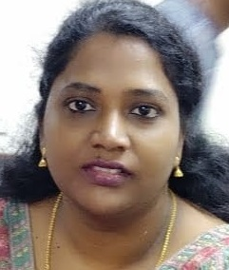
PAT ON THE BACK
Raditha's dedication to the Reliance Employee Engagement survey has been truly outstanding.
While it was a dead list and tough to crack, she ensured that we attempt to reach out to each of them more than 10 times. Updates on what is completed and how many attempts for each record were sent to the client regularly.
Well done Raditha! She has also completed 5 successful years in the AceNgage.
Looking forward to many more. Congratulations Raditha
RADITHA
Digital Certificate and
Gift voucher

Slide 13
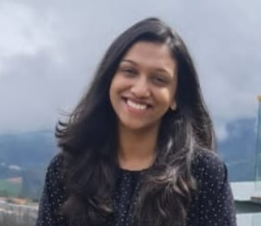
PAT ON THE BACK
Neeriksha ensures her adherence targets are achieved month on month. This month is a double whammy as she has ensured her quality too has crossed the benchmark.
Quick to take schedules and complete her calls , Neeriksha maintains a strong focus on her daily numbers.
A reliable employee is the best gift a leader can ask for, thank you for being someone your SME can rely on.
Your excellent performance is an inspiration to all. Keep up the good work.
NEERIKSHA MOHAN
Digital Certificate and
Gift voucher

Slide 14
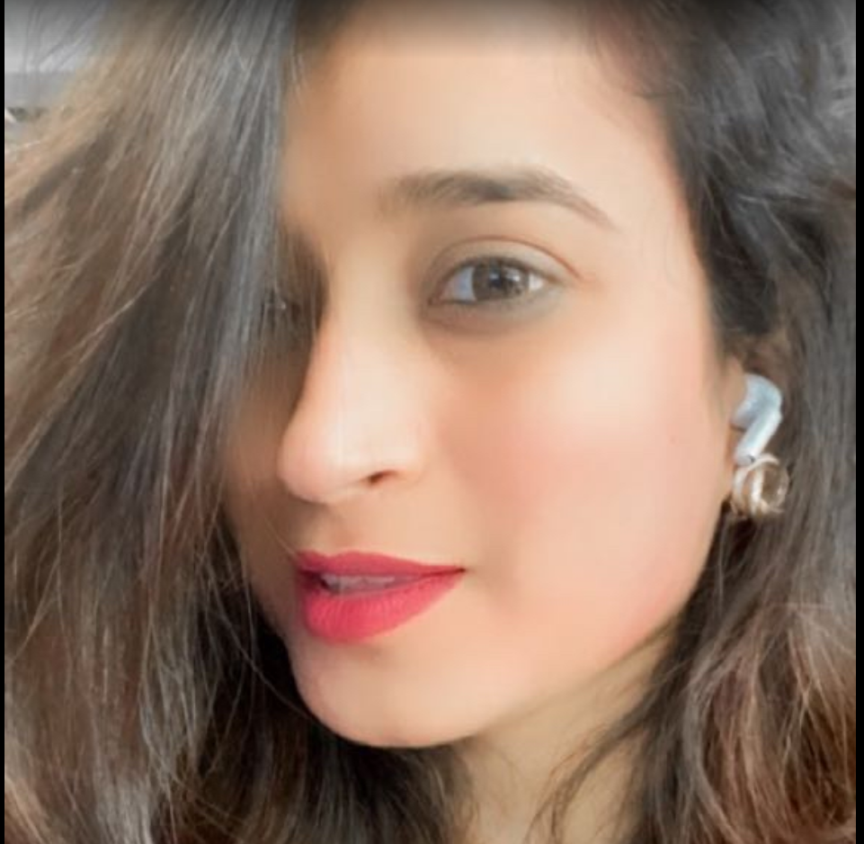
PAT ON THE BACK
Hemani is an active, enthusiastic, and passionate team member in Exit. Highly self-motivated to achieve her monthly numbers, she needs no follow up and no reminders.
Her keen participation on client calls, willingness to volunteer for test projects and assignments and just be a cheerleader for her team-mates is what makes her so special!
It’s great to have you as a part of the team and we wish you every success in future!
We are proud of you for the work that you do!
HEMANI SHAH
Digital Certificate and
Gift voucher

Slide 15
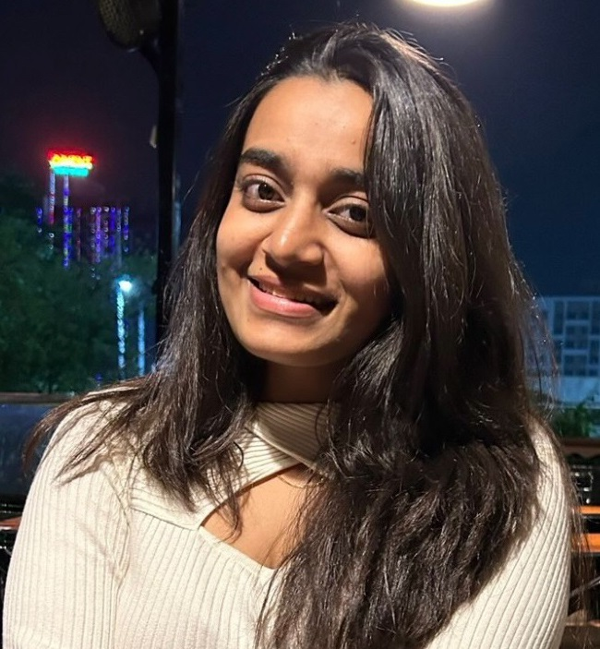
PAT ON THE BACK
Yet another star performer who needs no introduction!
Shraddha is awe inspiring in her consistency and commitment to achieving her KRAs. In addition to it , she’s always available to take on any special task or assignment given to her.
May you continue to achieve everything you set out to do and may you shine bright in your efforts !
Its been another phenomenal month of great performance from your end !
SHRADDHA WAGHMARE
Digital Certificate and
Gift voucher

Slide 16
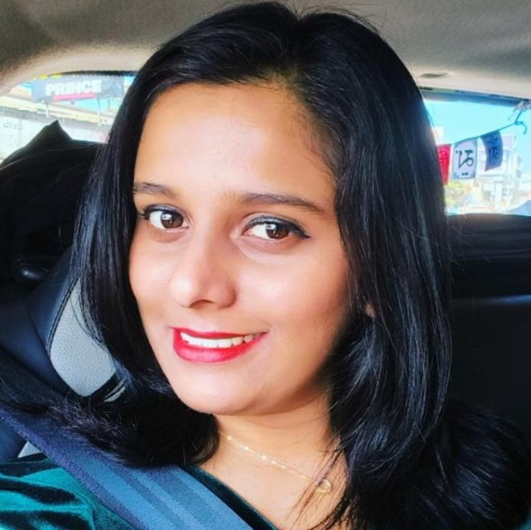
LEADERSHIP CHOICE
A long timer in AceNgage and one of our best SME’s, Riah has taken on several new challenges in the last few months.
From learning a new process like Web Surveys, to handling the data processing and client updation on her own, Riah has shown a willingness to learn and thereby grow in her talents and capabilities. This is in addition to handling special assignments/clients like Reliance and Unilever as well as managing a sizable exit team of counsellors.
Through it all her process orientation , hardwork and focus has been truly commendable.
Wishing you the very best as you continue to learn and grow in AceNgage !
RIAH PRAKASH
Digital Certificate and
Gift voucher

Slide 17
WINNERS LIST
CHAYA RAMESH
SWATHI M G
PRIYANKA KUMAR
SNEHA R H
MONICA SRIVASTAVA
SWATHI SHYAM
NEHA PRASAD
SNEHA LAL
SMITA ALEX
RADITHA
NEERIKSHA MOHAN
HEMANI SHAH
SHRADDHA WAGHMARE
RIAH PRAKASH

Slide 18
Well Done to the winners… – …Good Luck for May’23

